Slide 1






Chad Green

Slide 2






Who is Chad Green
chadgreen@chadgreen.com
TaleLearnCode
TaleLearnCode.com
ChadGreen & TaleLearnCode
ChadwickEGreen

Slide 3

What is Cosmos DB
The Hitchhiker’s Guide to the Cosmos
Notes:
NEXT: Turnkey global distribution

Slide 4

Azure Cosmos DB
A globally distributed, massively scalable, multi-model database service
Turnkey global distribution
Notes:
Turnkey Global Distribution
Enables you to build highly responsive and highly available applications worldwide
Transparently replicates your data wherever your users are, so your users can interact with a replica of the data that is closest to them
Add or remove any of the Azure regions to your Cosmos account at any time, with a click of a button
Cosmos DB will seamlessly replicate your data to all the regions associated with your account while your application continues to be highly available, thanks to the multi-homing capabilities
Always On
By virtue of deep integration with Azure infrastructure and transparent multi-master replication, Cosmos DB provides 99.999% high availability for both reads and writes.
Provides you the ability to programmatically or via Portal invoke the regional failover of your Cosmos account
Helps ensure that your application is designed to failover in the case of regional disaster

Slide 5
Azure Cosmos DB
A globally distributed, massively scalable, multi-model database service
Turnkey global distribution
Notes:
NEXT: Elastic scale out of storage & throughput

Slide 6
Azure Cosmos DB
A globally distributed, massively scalable, multi-model database service
Elastic scale out of storage & throughput
Turnkey global distribution
Notes:
Elastic scalability of throughput and storage, worldwide
Designed with transparent horizontal partitioning and multi-master replication
Offers unprecedent elastic scalability for your writes and reads, all around the globe
Elastically scale up from thousands to hundreds of millions of requests per second around the global with a single API call and pay only for the throughput (and storage) you need
Helps you deal with unexpected spikes in your workloads without having to over-provision for the peak

Slide 7
Azure Cosmos DB
A globally distributed, massively scalable, multi-model database service
Elastic scale out of storage & throughput
Turnkey global distribution
Notes:
NEXT: Guaranteed low latency at the 99th percentile

Slide 8
Azure Cosmos DB
A globally distributed, massively scalable, multi-model database service
Guaranteed low latency at the 99th percentile
Elastic scale out
of storage & throughput
Turnkey global distribution
Notes:
Guaranteed low latency at 99th percentile, worldwide
Using Cosmos DB, you can build highly responsive, planet scale applications
With its novel multi-master replication protocol and latch free and write-optimized database engine, Cosmos guarantees less than 10-ms latencies for both, reads (indexed) and writes at 99th percentile, all around the world
Capability ensures sustained ingestion of data and blazing-fast queries for highly responsive apps

Slide 9
Azure Cosmos DB
A globally distributed, massively scalable, multi-model database service
Guaranteed low latency at the 99th percentile
Elastic scale out
of storage & throughput
Turnkey global distribution
Notes:
NEXT: Five well-defined consistency models

Slide 10
Azure Cosmos DB
A globally distributed, massively scalable, multi-model database service
Five well-defined consistency models
Guaranteed low latency at the 99th percentile
Elastic scale out
of storage & throughput
Turnkey global distribution
Notes:
Strong; Bounded Staleness; Session; Consistent Prefix; Eventual

Slide 11
Azure Cosmos DB
A globally distributed, massively scalable, multi-model database service
Strong
Guaranteed low latency at the 99th percentile
Elastic scale out
of storage & throughput
Turnkey global distribution
Notes:
Strong
Strong Consistency provides the most predictable and intuitive programming model. When you configure your account with strong consistency level, Azure Cosmos DB provides linearizability guarantee.
This means that reads are guaranteed to see the most recent write.
Offers a linearizability guarantee
Reads are guaranteed to return the most recent committed version of an item
Client never sees an uncommitted or partial write
Users are always guaranteed to read the latest committed write.

Slide 12
Azure Cosmos DB
A globally distributed, massively scalable, multi-model database service
Strong
Guaranteed low latency at the 99th percentile
Elastic scale out
of storage & throughput
Turnkey global distribution
Notes:
NEXT: Bounded Staleness

Slide 13
Azure Cosmos DB
A globally distributed, massively scalable, multi-model database service
Strong
Bounded Staleness
Guaranteed low latency at the 99th percentile
Elastic scale out
of storage & throughput
Turnkey global distribution
Notes:
Bounded Staleness
Bounded staleness consistency is most frequently choose by globally distributed applications expecting low write latencies but total global order guarantees.
Unlike strong consistency, which is scoped to a single region, you can choose bounded stateliness consistency with any number of regions (along with a write region). Bounded staleness is great for applications featuring group collaboration and sharing, stock ticker, published-subscribe/querying, etc.
Reads are guaranteed to honor the consistent-prefix guarantee
Reads might lag behind writes by at most “K” versions (updates) of an item or by “T” time interval
When you choose, the “staleness” can be configured in two ways:
The number of versions (K) of the item
The time interval (T) by which the reads might lag behind the writes

Slide 14
Azure Cosmos DB
A globally distributed, massively scalable, multi-model database service
Strong
Bounded Staleness
Guaranteed low latency at the 99th percentile
Elastic scale out
of storage & throughput
Turnkey global distribution
Notes:
NEXT: Session

Slide 15
Azure Cosmos DB
A globally distributed, massively scalable, multi-model database service
Strong
Session
Bounded Staleness
Guaranteed low latency at the 99th percentile
Elastic scale out
of storage & throughput
Turnkey global distribution
Notes:
Session
Session consistency is most widely used consistency level both for single region as well as global distributed applications.
It provides write latencies, availability, and read throughput comparable to that of eventual consistency but also provides the consistency guarantees that suite the needs of application written to operate in the context of a user.
Reads are guaranteed to honor the consistent-prefix (assuming a single “writer” session), monotonic read, monotonic writes, read-your-writes, and write-follows reads guarantees
Session consistency is scoped to a client session

Slide 16
Azure Cosmos DB
A globally distributed, massively scalable, multi-model database service
Strong
Session
Bounded Staleness
Guaranteed low latency at the 99th percentile
Elastic scale out
of storage & throughput
Turnkey global distribution
Notes:
NEXT: Consistent Prefix

Slide 17
Azure Cosmos DB
A globally distributed, massively scalable, multi-model database service
Strong
Consistent Prefix
Bounded Staleness
Session
Guaranteed low latency at the 99th percentile
Elastic scale out
of storage & throughput
Turnkey global distribution
Notes:
Consistent Prefix
Consistent prefix level guarantees that reads never see out of order writes.
If writes were performed in the order ‘A, B, C’, then a client sees either ‘A’, ‘A,B’, or ‘A,B,C’, but never out of order like ‘A,C’, or ‘B,A,C’. Consistent Prefix provides write latencies, availability and read throughput comparable to that of eventual consistency, but also provides the order guarantees that suit the needs of scenarios where order is important.
Updates that are returned contain some prefix of all the updates, with no gaps
Guarantees that reads never see out-of-order writes

Slide 18
Azure Cosmos DB
A globally distributed, massively scalable, multi-model database service
Strong
Consistent Prefix
Bounded Staleness
Session
Guaranteed low latency at the 99th percentile
Elastic scale out
of storage & throughput
Turnkey global distribution
Notes:
NEXT: Eventual

Slide 19
Azure Cosmos DB
A globally distributed, massively scalable, multi-model database service
Strong
Eventual
Bounded Staleness
Session
Consistent Prefix
Guaranteed low latency at the 99th percentile
Elastic scale out
of storage & throughput
Turnkey global distribution
Notes:
Eventual
Eventual consistency is the weakest form of consistency wherein a client may get the values which are older than the ones it had seen before, over time.
In the absence of any further writes, the replicas within the group will eventually converge. Eventual consistency is ideal where the application does not require any ordering guarantees. Examples include count of Retweets, Likes, or non-threaded comments.
No ordering guarantee for reads
In the absence of any further writes, the replicas eventually converge
NEXT: Comprehensive SLAs

Slide 20
Azure Cosmos DB
A globally distributed, massively scalable, multi-model database service
Comprehensive
SLAs
Guaranteed low latency at the 99th percentile
Elastic scale out
of storage & throughput
Five well-defined consistency models
Turnkey global distribution
Notes:
Industry Leading Comprehensive SLAs
First and only service to offer industry-leading comprehensive SLAs encompassing 5-nine availability, read and write latency at the 99th percentile, guaranteed throughput, and consistency.

Slide 21
Azure Cosmos DB
A globally distributed, massively scalable, multi-model database service
Comprehensive
SLAs
Guaranteed low latency at the 99th percentile
Elastic scale out
of storage & throughput
Five well-defined consistency models
Turnkey global distribution

Slide 22
Azure Cosmos DB
A globally distributed, massively scalable, multi-model database service
Column-family
Document
Key-value
Graph
Guaranteed low latency at the 99th percentile
Elastic scale out
of storage & throughput
Five well-defined consistency models
Turnkey global distribution
Comprehensive SLAs

Slide 23




Azure Cosmos DB
A globally distributed, massively scalable, multi-model database service
Core (SQL) API
Table API
MongoDB
Column-family
Document
Key-value
Graph
Guaranteed low latency at the 99th percentile
Elastic scale out
of storage & throughput
Five well-defined consistency models
Turnkey global distribution
Comprehensive SLAs

Slide 24



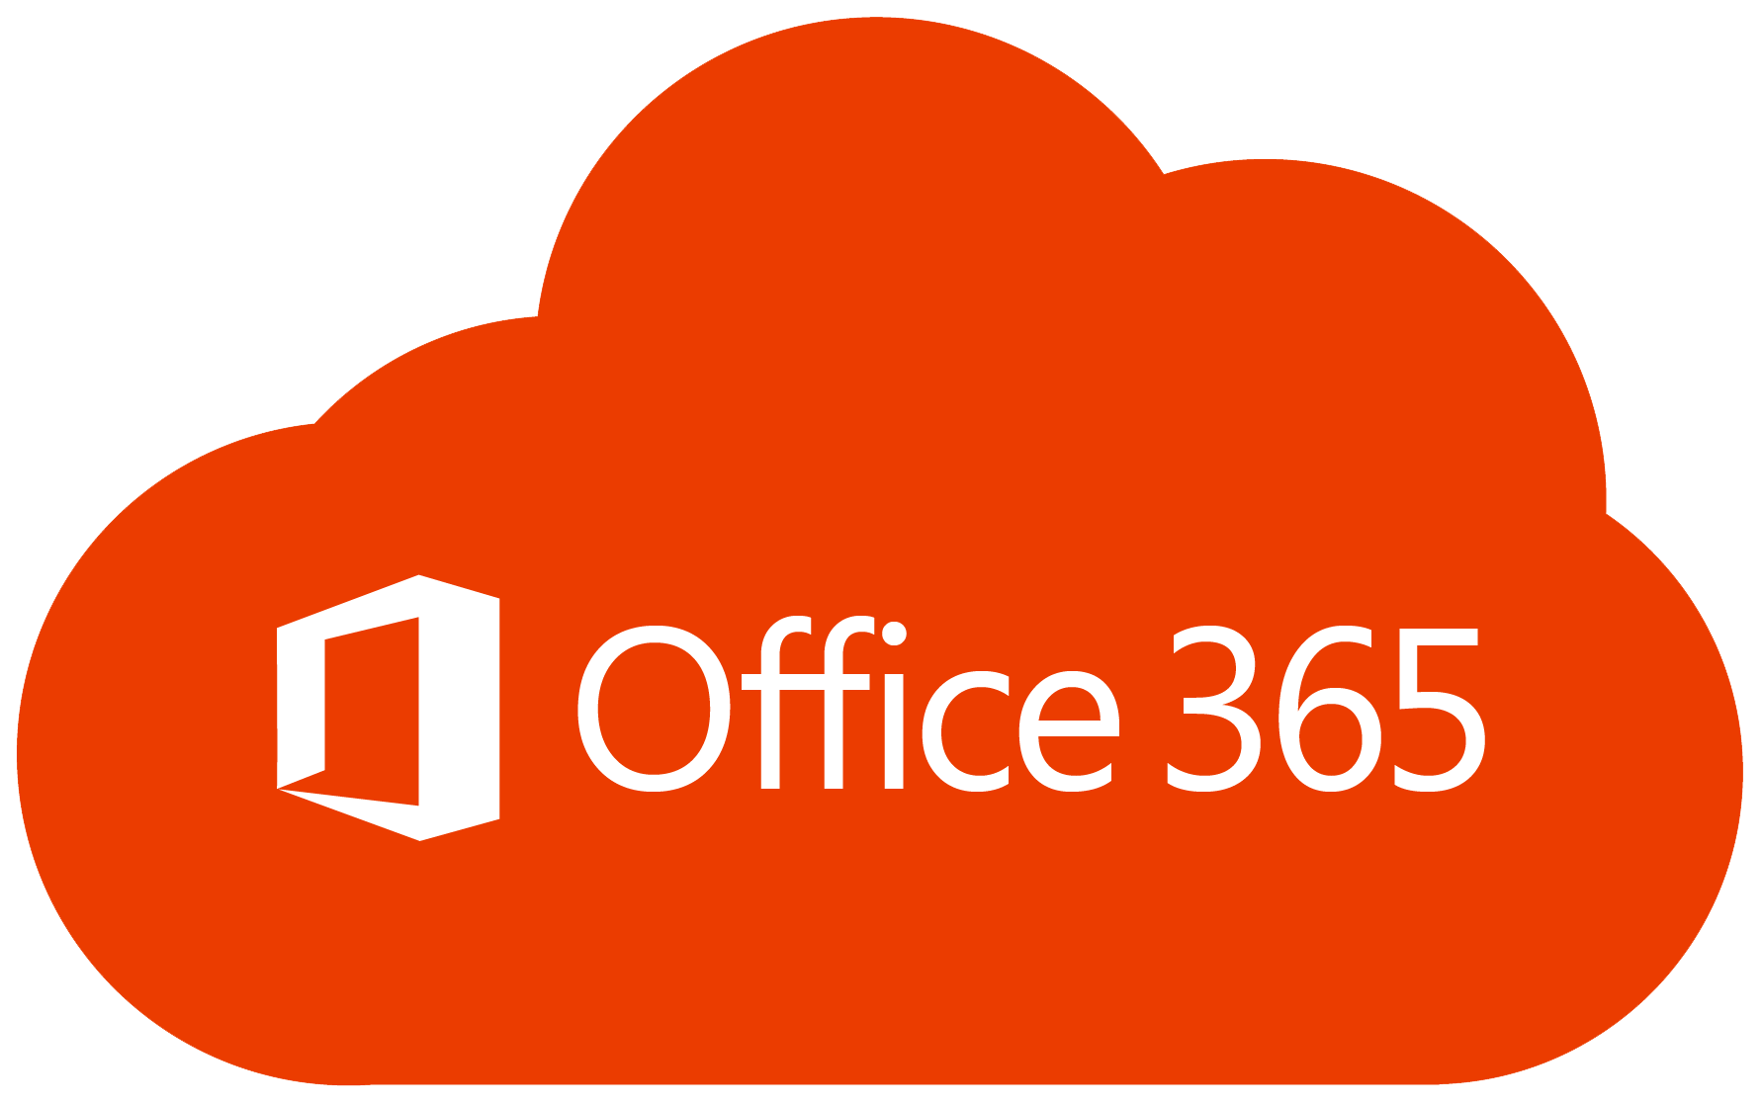

Azure Cosmos DB
A globally distributed, massively scalable, multi-model database service
What if we have REALLY large data requirements?

Slide 25
Azure Cosmos DB Capabilities
Resource | Default Limit
Maximum RUs per container | 1,000,000
Maximum RUs per database | 1,000,000
Maximum RUs per (logical) partition key | 20-Gb
Maximum number of distinct (logical) partition keys | Unlimited
Maximum storage per container | Unlimited
Maximum storage per database | Unlimited
Maximum size of an item | 2-Mb
Notes:
IMPORTANT: 10-Gb storage limit per logical partition key
FUNNY: Documentation for limits has “No practical limit”
Maximum length of property name/value
maximum number of properties per item
But note that the maximum size of an item is 2-Mb (UTF-8 length of JSON representation)

Slide 26

Cosmos
Use Cases
The Hitchhiker’s Guide to the Cosmos

Slide 27
IoT and Telematics
Azure Cosmos DB Use Cases
Ingest Bursts of Data
Process and Analyze Streaming Data
Archive Data to Cold Storage
Notes:
IoT use cases commonly share some patterns in how they ingest, process, and store data:
Systems need to ingest bursts of data from devices sensors of various locales
Systems process and analyze streaming data to derive real-time insights
Data is then archived to cold storage for batch analytics

Slide 28
IoT and Telematics
Azure Cosmos DB Use Cases
Ingest Bursts of Data
Process and Analyze Streaming Data
Archive Data to Cold Storage
Notes:
IoT use cases commonly share some patterns in how they ingest, process, and store data:
Systems need to ingest bursts of data from devices sensors of various locales
Systems process and analyze streaming data to derive real-time insights
Data is then archived to cold storage for batch analytics

Slide 29
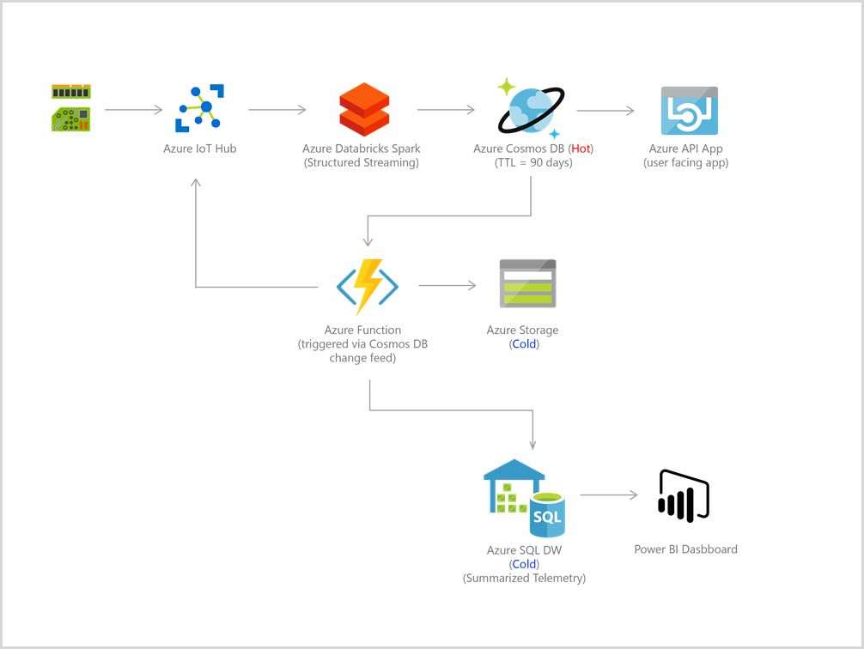
IoT and Telematics
Azure Cosmos DB Use Cases
Notes:
Bursts of data can be ingested by Azure Event Hubs as it offers high throughput data ingestion with low latency.
Data ingested that needs to be processed for real-time insight can be funneled to Azure Stream Analytics for real-time analytics.
Data can be loaded into Azure Cosmos DB for adhoc querying.
Then all data or just changes to data in Azure Cosmos DB can be used as reference data as part of real-time analytics.
In addition, data can further be refined and processed by connecting Azure Cosmos DB data to HDInsight for Pig, Hive, or Map/Reduce jobs.
Refined data is then loaded back to Azure Cosmos DB for reporting.

Slide 30
Retail Marketing
Azure Cosmos DB Use Cases
Storing and querying sets of attributes
User Accounts
Product Catalogs
IoT Device Registers
Notes:
Used extensively by Microsoft’s own e-commerce platforms
Storing and querying a set of attributes for entities
Examples of catalog data
User Accounts
Product Catalogs
IoT Device Registries

Slide 31
Retail Marketing
Azure Cosmos DB Use Cases
Storing and querying sets of attributes
User Accounts
Product Catalogs
IoT Device Registers

Slide 32
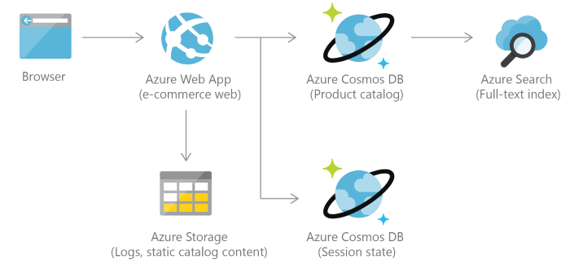
Retail and Marketing
Azure Cosmos DB Use Cases
Notes:
Consider an example of a product catalog for an automotive parts supplier. Every part may have its own attributes in addition to the common attributes that all parts share. Furthermore, attributes for a specific part can change the following year when a new model is released. Azure Cosmos DB supports flexible schemas and hierarchical data, and thus it is well suited for storing product catalog data.

Slide 33
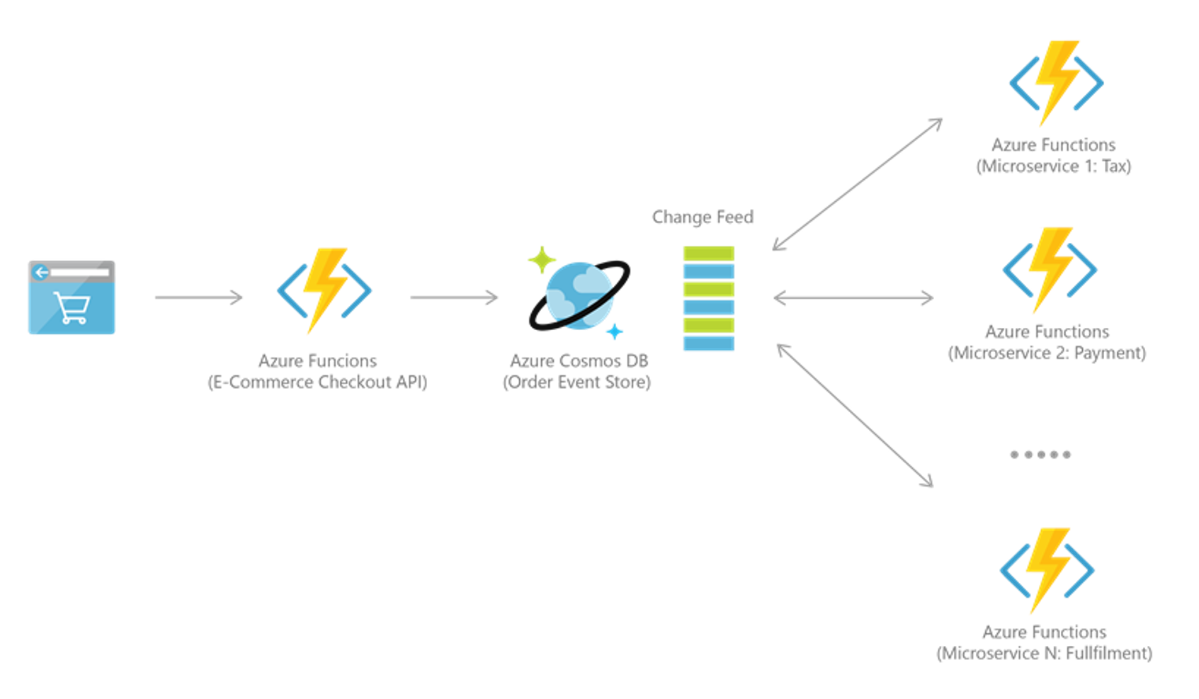
Retail and Marketing
Azure Cosmos DB Use Cases
Notes:
Azure Cosmos DB is often used for event sourcing to power event driven architectures using its change feed functionality. The change feed provides downstream microservices the ability to reliably and incrementally read inserts and updates (for example, order events) made to an Azure Cosmos DB. This functionality can be leveraged to provide a persistent event store as a message broker for state-changing events and drive order processing workflow between many microservices (which can be implemented as serverless Azure Functions).

Slide 34


Gaming
Azure Cosmos DB Use Cases
Single-Millisecond Latencies
Handle Massive Spikes
Notes:
The database tier is a crucial component of gaming applications. Modern games perform graphical processing on mobile/console clients, but rely on the cloud to deliver customized and personalized content like in-game states, social media integration, and high-score leaderboards.
Games often require single-millisecond latencies for reads and writes to provide an engaging in-game experience
A game engine needs to be fast and able to handle massive spikes in request rates during new game launches and feature updates.
Examples of games using Cosmos:
The Walking Dead: No Man’s Land
Halo 5: Guardians

Slide 35
Gaming
Azure Cosmos DB Use Cases
Single-Millisecond Latencies
Handle Massive Spikes
Notes:
The database tier is a crucial component of gaming applications. Modern games perform graphical processing on mobile/console clients, but rely on the cloud to deliver customized and personalized content like in-game states, social media integration, and high-score leaderboards.
Games often require single-millisecond latencies for reads and writes to provide an engaging in-game experience
A game engine needs to be fast and able to handle massive spikes in request rates during new game launches and feature updates.
Examples of games using Cosmos:
The Walking Dead: No Man’s Land
Halo 5: Guardians

Slide 36
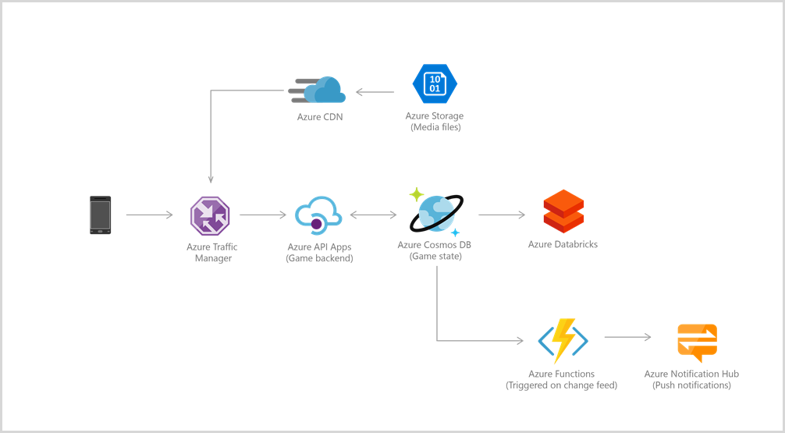
Gaming
Azure Cosmos DB Use Cases
Notes:
Azure Cosmos DB is often used for event sourcing to power event driven architectures using its change feed functionality. The change feed provides downstream microservices the ability to reliably and incrementally read inserts and updates (for example, order events) made to an Azure Cosmos DB. This functionality can be leveraged to provide a persistent event store as a message broker for state-changing events and drive order processing workflow between many microservices (which can be implemented as serverless Azure Functions).

Slide 37
Web & Mobile Applications
Azure Cosmos DB Use Cases
Modeling Social Interactions
Integrating with Third-Party Services
Building Rich Personalized Experiences
Notes:
Commonly used within web and mobile applications, and is well suited for modeling social interactions, integrating with third-party services, and building rich personalized experiences.
Two very common use cases are Social Applications and Personalization

Slide 38
Web & Mobile Applications
Azure Cosmos DB Use Cases
Modeling Social Interactions
Integrating with Third-Party Services
Building Rich Personalized Experiences
Notes:
Commonly used within web and mobile applications, and is well suited for modeling social interactions, integrating with third-party services, and building rich personalized experiences.
Two very common use cases are Social Applications and Personalization

Slide 39
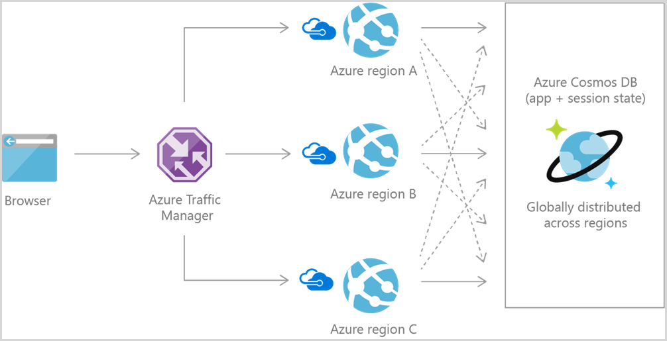
Gaming
Azure Cosmos DB Use Cases
Notes:
Common use case for Azure Cosmos DB is to store and query user generated content for web, mobile, and social media applications
Examples are chat sessions, tweets, blog posts, ratings, and comments.
Most social applications run at global scale and can exhibit unpredictable usage patterns. Flexibility in scaling the data store is essential as application layer scales to match usage demand.
You can create additional Cosmos DB accounts across multiple regions.

Slide 40

Integrations
The Hitchhiker’s Guide to the Cosmos

Slide 41

Cosmos DB Integrations
Notes:
Apache Spark

Slide 42
Cosmos DB Integrations
Notes:
Etch API

Slide 43

Cosmos DB Integrations
Notes:
Etch API

Slide 44
Cosmos DB Integrations
Notes:
Change Feed

Slide 45

Cosmos DB Integrations
Notes:
Change Feed

Slide 46
Cosmos DB Integrations
Notes:
Azure Functions

Slide 47

Cosmos DB Integrations
Notes:
Azure Functions

Slide 48
Cosmos DB Integrations
Notes:
Azure Logic Apps

Slide 49

Cosmos DB Integrations
Notes:
Azure Logic Apps

Slide 50
Cosmos DB Integrations
Notes:
Microsoft Flow

Slide 51

Cosmos DB Integrations
Notes:
Microsoft Flow

Slide 52








Wide-Range of Data APIs
The Hitchhiker’s Guide to the Cosmos

Slide 53
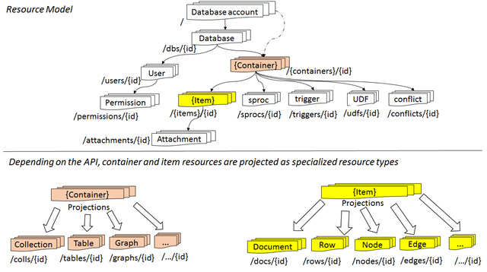
Atom Resource Sequence
Wide-Range of Data APIs
Notes:
Each resource is uniquely identified by a stable and logical URI and represented as a JSON document.
The overall resource model of an application using Azure Cosmos DB is a hierarchical overlay of the resources rooted under the database account, and can be navigated using hyperlinks.
<CLICK>
The content model of the item resource is based on atom-record-sequence (ARS). Both, container and item resources are further projected as reified resource types for a specific type of API interface. For example, while using document-oriented APIs, container and item resources are projected as collection (container) and document (item) resources, respectively; likewise, for graph-oriented API access, the underlying container and item resources are projected as graph (container), node (item) and edge (item) resources respectively; while accessing using a key-value API, table (container) and item/row (item) are projected.
Azure Cosmos DB uses an atom-record-sequence (ARS) system. Basically, the Cosmos DB translates all data models into atom-record-sequence based models.
So, everything becomes either an atom, a record or a sequence.
An atom is a primitive type.
A record is a struct
A sequence is an array of either atoms, records or structs.

Slide 54

SQL API
Document Database

Slide 55
SQL API – What
Wide-Range of Data APIs
Document Database
SQL to Query JSON Documents
JavaScript Programming Model
Notes:
The Cosmos DB SQL API supports querying items using Structured Query Language (SQL) as a JSON query language.
The design goals of the query language are to:
Support SQL, one of the most familiar and popular query languages, instead of investing a new query language. SQL provides a formal programming model for rich queries over JSON items.
Use JavaScript’s programming model as the foundation for the query language.
JavaScript’s type system, expressive evaluation, and function invocation are the roots of the SQL API.
These roots provide a natural programming model for features like relational projections, hierarchical navigation across JSON items, self-joins, spatial queries, and invocation of user-defined functions written entirely in JavaScript

Slide 56
SQL API – When
Wide-Range of Data APIs
Building a new non-relational document database and want to query using SQL
Notes:
Use the SQL API if you are building a new non-relational document database and want to query using familiar SQL syntax.

Slide 57
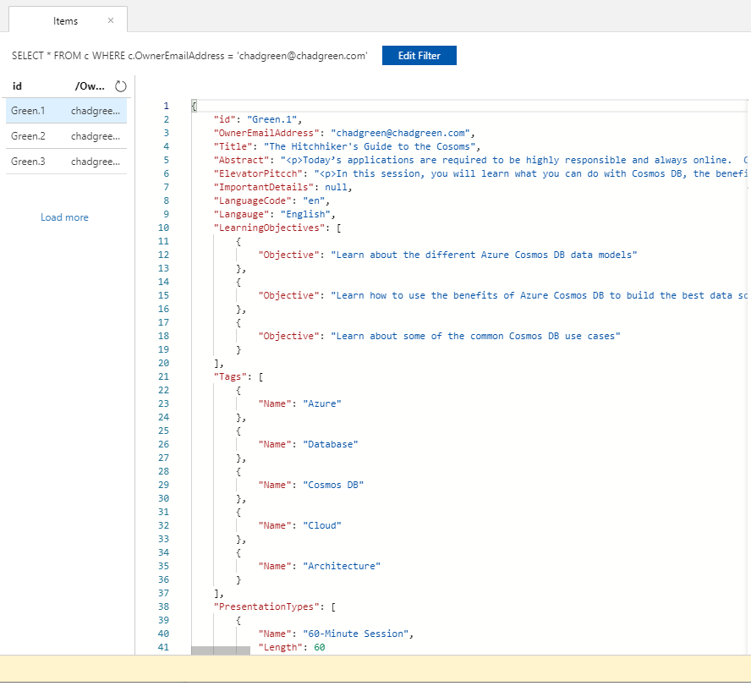
SQL API – How: Data Model
Wide-Range of Data APIs
Notes:
using familiar SQL syntax.

Slide 58
SQL API – How: Data Model
Wide-Range of Data APIs
SELECT * FROM c WHERE c.OwnerEmailAddress =
‘chadgreen@chadgreen.com’
Notes:
using familiar SQL syntax.

Slide 59
SQL API – How: Insert
Wide-Range of Data APIs
public class Presentation
{
[JsonProperty(PropertyName = "id")]
public string Id { get; set; }
public string OwnerEmailAddress { get; set; }
public string Title { get; set; }
public string Abstract { get; set; }
public string ElevatorPitcch { get; set; }
public string ImportantDetails { get; set; }
public string LanguageCode { get; set; }
public string Langauge { get; set; }
public LearningObjective[] LearningObjectives { get; set; }
public Tag[] Tags { get; set; }
public PresentationType[] PresentationTypes { get; set; }
}
Notes:
Point out the JsonProperty – PropertyName on next slide

Slide 60
SQL API – How: Insert
Wide-Range of Data APIs
public class Presentation
{
[JsonProperty(PropertyName = "id")]
public string Id { get; set; }
public string OwnerEmailAddress { get; set; }
public string Title { get; set; }
public string Abstract { get; set; }
public string ElevatorPitcch { get; set; }
public string ImportantDetails { get; set; }
public string LanguageCode { get; set; }
public string Langauge { get; set; }
public LearningObjective[] LearningObjectives { get; set; }
public Tag[] Tags { get; set; }
public PresentationType[] PresentationTypes { get; set; }
}
Notes:
Point out the JsonProperty - PropertyName

Slide 61
SQL API – How: Insert
Wide-Range of Data APIs
private async Task AddPresentation(ExistingPresentation existingPresentation)
{
Presentation presentation = Generate.Presentation(existingPresentation);
try
{
ItemResponse<Presentation> presentationResponse =
await this.container.ReadItemAsync<Presentation>(presentation.Id,
new PartitionKey(presentation.OwnerEmailAddress));
Console.WriteLine("Item in database with id: {0} already exists\n",
presentationResponse.Resource.Id);
}
catch
(
CosmosException ex) when (ex.StatusCode == HttpStatusCode.NotFound)
{
ItemResponse<Presentation> presentationResponse =
await this.container.CreateItemAsync<Presentation>(presentation,
new PartitionKey(presentation.OwnerEmailAddress));
Console.WriteLine("Created item with id: {0} Using {1} RUs.\n",
presentationResponse.Resource.Id, presentationResponse.RequestCharge);
}
}
}

Slide 62
SQL API – How: Insert
Wide-Range of Data APIs
private async Task AddPresentation(ExistingPresentation existingPresentation)
{
Presentation presentation = Generate.Presentation(existingPresentation);
try
{
ItemResponse<Presentation> presentationResponse =
await this.container.ReadItemAsync<Presentation>(presentation.Id,
new PartitionKey(presentation.OwnerEmailAddress));
Console.WriteLine("Item in database with id: {0} already exists\n",
presentationResponse.Resource.Id);
}
catch
(
CosmosException ex) when (ex.StatusCode == HttpStatusCode.NotFound)
{
ItemResponse<Presentation> presentationResponse =
await this.container.CreateItemAsync<Presentation>(presentation,
new PartitionKey(presentation.OwnerEmailAddress));
Console.WriteLine("Created item with id: {0} Using {1} RUs.\n",
presentationResponse.Resource.Id, presentationResponse.RequestCharge);
}
}
}
Notes:
Try and read the document; will get an 404 if not present

Slide 63
SQL API – How: Insert
Wide-Range of Data APIs
private async Task AddPresentation(ExistingPresentation existingPresentation)
{
Presentation presentation = Generate.Presentation(existingPresentation);
try
{
ItemResponse<Presentation> presentationResponse =
await this.container.ReadItemAsync<Presentation>(presentation.Id,
new PartitionKey(presentation.OwnerEmailAddress));
Console.WriteLine("Item in database with id: {0} already exists\n",
presentationResponse.Resource.Id);
}
catch
(
CosmosException ex) when (ex.StatusCode == HttpStatusCode.NotFound)
{
ItemResponse<Presentation> presentationResponse =
await this.container.CreateItemAsync<Presentation>(presentation,
new PartitionKey(presentation.OwnerEmailAddress));
Console.WriteLine("Created item with id: {0} Using {1} RUs.\n",
presentationResponse.Resource.Id, presentationResponse.RequestCharge);
}
}
}
Notes:
Try and read the document; will get an 404 if not present
If fail; create the item
Can get the number of RUs consumed for the operation

Slide 64
SQL API – How: Query
Wide-Range of Data APIs
private async Task QueryPresentationsAsync()
{
var sqlQueryText = "SELECT * FROM c WHERE c.OwnerEmailAddress = 'chadgreen@chadgreen.com'";
Console.WriteLine("Running query: {0}\n", sqlQueryText);
QueryDefinition queryDefinition = new QueryDefinition(sqlQueryText);
FeedIterator<Presentation> queryResultSetIterator
= this.container.GetItemQueryIterator<Presentation>(queryDefinition);
List<Presentation> presentations = new List<Presentation>();
while (queryResultSetIterator.HasMoreResults)
{
FeedResponse<Presentation> currentResultSet = await queryResultSetIterator.ReadNextAsync();
foreach (Presentation presentation in currentResultSet)
{
presentations.Add(presentation);
Console.WriteLine($"\t{presentation.Title}");
}
}
}

Slide 65
SQL API – How: Query
Wide-Range of Data APIs
private async Task QueryPresentationsAsync()
{
var sqlQueryText = "SELECT * FROM c WHERE c.OwnerEmailAddress = 'chadgreen@chadgreen.com'";
Console.WriteLine("Running query: {0}\n", sqlQueryText);
QueryDefinition queryDefinition = new QueryDefinition(sqlQueryText);
FeedIterator<Presentation> queryResultSetIterator
= this.container.GetItemQueryIterator<Presentation>(queryDefinition);
List<Presentation> presentations = new List<Presentation>();
while (queryResultSetIterator.HasMoreResults)
{
FeedResponse<Presentation> currentResultSet = await queryResultSetIterator.ReadNextAsync();
foreach (Presentation presentation in currentResultSet)
{
presentations.Add(presentation);
Console.WriteLine($"\t{presentation.Title}");
}
}
}

Slide 66
SQL API – How: Query
Wide-Range of Data APIs
private async Task QueryPresentationsAsync()
{
var sqlQueryText = "SELECT * FROM c WHERE c.OwnerEmailAddress = 'chadgreen@chadgreen.com'";
Console.WriteLine("Running query: {0}\n", sqlQueryText);
QueryDefinition queryDefinition = new QueryDefinition(sqlQueryText);
FeedIterator<Presentation> queryResultSetIterator
= this.container.GetItemQueryIterator<Presentation>(queryDefinition);
List<Presentation> presentations = new List<Presentation>();
while (queryResultSetIterator.HasMoreResults)
{
FeedResponse<Presentation> currentResultSet = await queryResultSetIterator.ReadNextAsync();
foreach (Presentation presentation in currentResultSet)
{
presentations.Add(presentation);
Console.WriteLine($"\t{presentation.Title}");
}
}
}

Slide 67
SQL API – How: Query
Wide-Range of Data APIs
private async Task QueryPresentationsAsync()
{
var sqlQueryText = "SELECT * FROM c WHERE c.OwnerEmailAddress = 'chadgreen@chadgreen.com'";
Console.WriteLine("Running query: {0}\n", sqlQueryText);
QueryDefinition queryDefinition = new QueryDefinition(sqlQueryText);
FeedIterator<Presentation> queryResultSetIterator
= this.container.GetItemQueryIterator<Presentation>(queryDefinition);
List<Presentation> presentations = new List<Presentation>();
while (queryResultSetIterator.HasMoreResults)
{
FeedResponse<Presentation> currentResultSet = await queryResultSetIterator.ReadNextAsync();
foreach (Presentation presentation in currentResultSet)
{
presentations.Add(presentation);
Console.WriteLine($"\t{presentation.Title}");
}
}
}

Slide 68
SQL API – Querying Options
Wide-Range of Data APIs
API
LINQ to SQL
JavaScript
Entity Framework
Notes:
API (using Microsoft.Azure.Cosmos)
LINQ to SQL API
JavaScript
Stored Procedures
Triggers
User Defined Functions
Entity Framework

Slide 69

MongoDB
Document Database

Slide 70
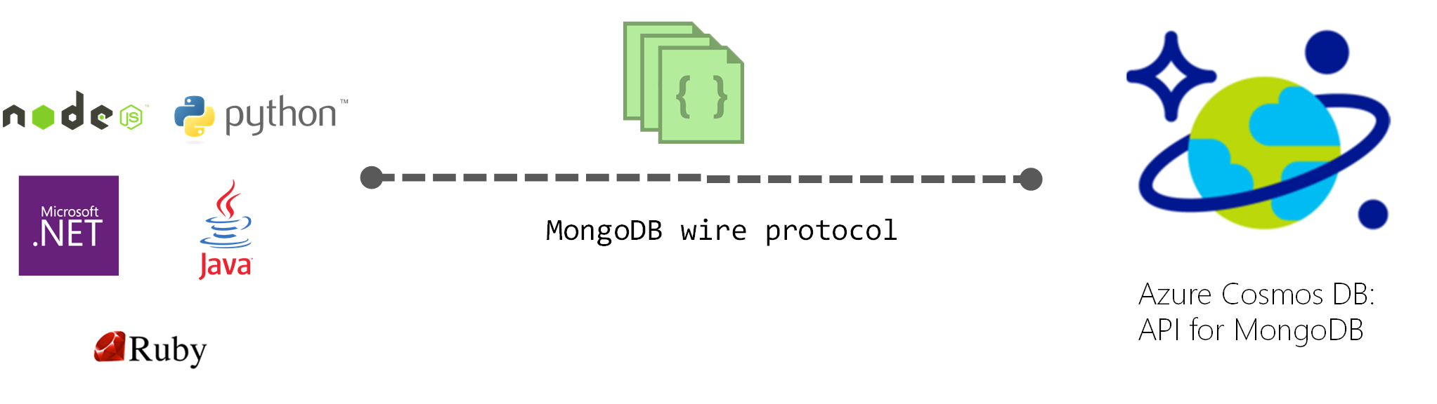
MongoDB – What
Wide-Range of Data APIs
Native Implementation
Interact Transparently
V3.6 Compatibility
Notes:
Provides a native implementation of the wire protocols directly and efficiently inside Cosmos DB, it allows existing client SDKs, drivers, and tools to intact transparently
By default, compatible with Mongo version 3.2/3.6 wire protocol
Any MongoDB client driver that understands these protocol versions should be able to natively connect

Slide 71
MongoDB – When
Wide-Range of Data APIs
Migrating data from a MongoDB database to Azure Cosmos DB’s fully managed service
Notes:
Easily migrate your application to Cosmos DB while preserving significant portions of your application logic
Keep your application portable and continue to remain cloud vendor-agnostic
Get industry leading, financially backed SLAs for the common NoSQL APIs powered by Cosmos DB
Elastically scale the provisioned throughput and storage based on your need and pay only for the throughput and storage you need – significant cost savings
Turnkey, global distribution with multi-master replication

Slide 72
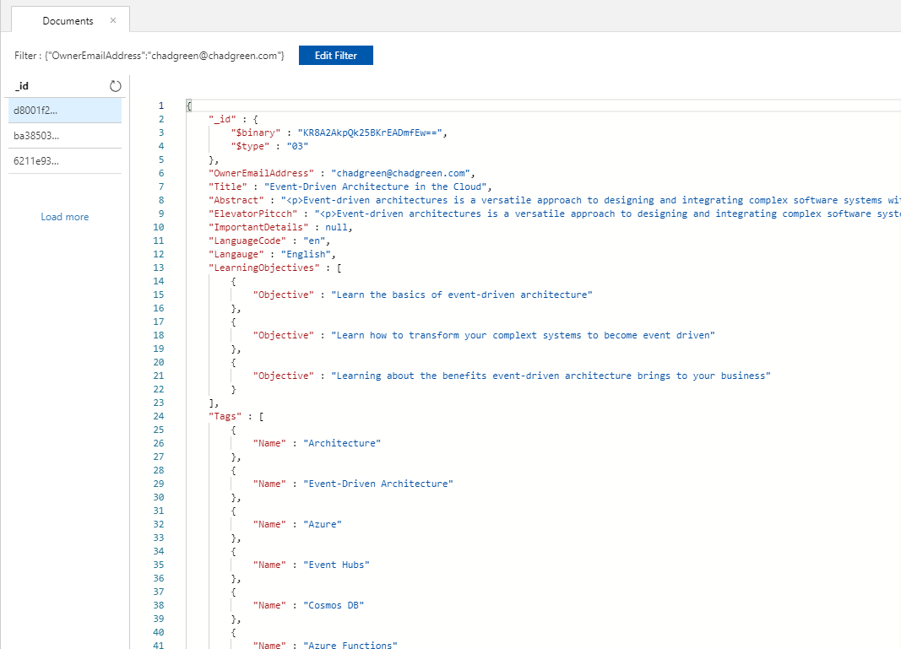
MongoDB – How: Data Model
Wide-Range of Data APIs

Slide 73
MongoDB – How: Data Model
Wide-Range of Data APIs
Filter: {"OwnerEmailAddress":
"chadgreen@chadgreen.com"}

Slide 74
MongoDB – How: Insert
Wide-Range of Data APIs
public class Presentation
{
[BsonId(IdGenerator =typeof(CombGuidGenerator))] public Guid Id { get; set; }
[BsonElement("OwnerEmailAddress")] public string OwnerEmailAddress { get; set; }
[BsonElement("Title")] public string Title { get; set; }
[BsonElement("Abstract")] public string Abstract { get; set; }
[BsonElement("ElevatorPitcch")] public string ElevatorPitcch { get; set; }
[BsonElement("ImportantDetails")] public string ImportantDetails { get; set; }
[BsonElement("LanguageCode")] public string LanguageCode { get; set; }
[BsonElement("Langauge")] public string Langauge { get; set; }
[BsonElement("LearningObjectives")] public LearningObjective[] LearningObjectives { get; set; }
[BsonElement("Tags")] public Tag[] Tags { get; set; }
[BsonElement("PresentationTypes")] public PresentationType[] PresentationTypes { get; set; }
}

Slide 75
MongoDB – How: Insert
Wide-Range of Data APIs
public void CreatePresentation(Presentation presentation)
{
var collection = GetPresentationsCollection();
try
{
collection.InsertOne(presentation);
}
catch (MongoCommandException ex)
{
string msg = ex.Message;
}
}

Slide 76
MongoDB – How: Insert
Wide-Range of Data APIs
private IMongoCollection<Presentation> GetPresentationsCollection()
{
MongoClientSettings settings = new MongoClientSettings();
settings.Server = new MongoServerAddress(host, 10255);
settings.UseTls = true;
settings.SslSettings = new SslSettings();
settings.SslSettings.EnabledSslProtocols = SslProtocols.Tls12;
MongoIdentity identity = new MongoInternalIdentity(dbName, userName);
MongoIdentityEvidence evidence = new PasswordEvidence(password);
settings.Credential = new MongoCredential("SCRAM-SHA-1", identity, evidence);
MongoClient client = new MongoClient(settings);
var database = client.GetDatabase(dbName);
var presetationCollection = database.GetCollection<Presentation>(collectionName);
return presetationCollection;
}

Slide 77
MongoDB – How: Query
Wide-Range of Data APIs
public List<Presentation> GetAllPresentations()
{
try { var collection = GetPresentationsCollection();
return collection.Find(new BsonDocument()).ToList();
}
catch (MongoConnectionException)
{
return new List<Presentation>();
}
}

Slide 78
MongoDB – Cosmos or Atlas
Wide-Range of Data APIs
Cosmos DB
Small documents – the smaller the cheaper
Read more often than write
Like idea to start small and pay-as-you-go
Support included in Azure subscription
Need a guaranteed latency despite usage
MongoDB Atlas
Any size documents (only choice for documents over 2-Mb)
Like to have a fixed budget for storage
Use Mongo-API features that are not covered by Cosmos DB
Freedom to create unique indexes
Write data more often than read
Want to decide backup policy
https://blog.chudinov.net/azure-cosmosdb-vs-mongodb-atlas/

Slide 79
Graph API
Graph Database

Slide 80
Graph API – What
Wide-Range of Data APIs
Vertices and Edges
Natural Data Representation
Model All Kinds of Scenarios
Notes:
Formally, a graph is just a collection of vertices and edges – or, in less formal language, a set of nodes and the relationships that connect them.
Graphs represent entities as vertices and the ways in which those entities relate to the world as relationships (or edges).
This general-purpose, expressive structure allows us to model all kinds of scenarios

Slide 81
What is a Graph
Wide-Range of Data APIs
Notes:
Formally, a graph is just a collection of vertices and edges – or, in less formal language, a set of nodes and the relationships that connect them.
Graphs represent entities as vertices and the ways in which those entities relate to the world as relationships (or edges).
This general-purpose, expressive structure allows us to model all kinds of scenarios

Slide 82
Property Graph Model
Wide-Range of Data APIs
Contains nodes (vertices) and relationships (edges)
Nodes and relationships contain properties
Relationships are named and directed with a start and end node
Name: Chad Green
Location: Louisville, KY
Title: Director of Software Development
Name: ScholarRx
Location: Elizabethtown, KY
Employee
Company
Works For
Date of Employment: 2/28/2019
Notes:
Formally, a graph is just a collection of vertices and edges – or, in less formal language, a set of nodes and the relationships that connect them.
Graphs represent entities as vertices and the ways in which those entities relate to the world as relationships (or edges).
This general-purpose, expressive structure allows us to model all kinds of scenarios

Slide 83
The Power of Graph Databases
Wide-Range of Data APIs
Performance
Notes:
Notwithstanding the fact that just about anything can be modeled as a graph; that a graph database provides a powerful but novel data modeling technique does not itself provide sufficient justification for replacing a well-established, well-understood data platform; there must also be an immediate and very significant practical benefit. In the case of graph databases, this motivation exists in the form of a set of use cases and data patterns whose performance improves by one or more orders of magnitude when implemented in a graph, and whose latency is much lower compared to batch processing of aggregates. On top of this performance benefit, graph databases offer an extremely flexible data model, and mode of delivery aligned with today’s agile software delivery practices.
Performance
One compelling reason for choosing a graph database is the sheer performance increase when dealing with connected data verses relational databases and NOSQL stores. In contrast to relational databases, where join-intensive query performance deteriorates as the dataset gets bigger, with a graph database performance tends to remain relatively constant, even as the dataset grows. This is because queries are localized to a portion of the graph. As a result, the execution time for each query is proportional only to the size of the part of the graph traversed to satisfy that query, rather than the size of the overall graph

Slide 84
The Power of Graph Databases
Wide-Range of Data APIs
Performance
Flexibility
Notes:
Flexibility
As developers and data architects, we want to connect data as the domain dictates, thereby allowing structure and schema to emerge in tandem with our growing understanding of the problem space, rather than being imposed upfront, when we know least about the real shape and intricacies of the data. Graph databases address this want directly. The graph data model expresses and accommodates business needs in a way that enables IT to move at the speed of business.

Slide 85
The Power of Graph Databases
Wide-Range of Data APIs
Performance
Flexibility
Agility
Notes:
Agility
We want to be able to evolve our data model in step with the rest of our application, using a technology aligned with today’s incremental and iterative software delivery practices. Modern graph databases equip us to perform frictionless development and graceful system maintenance. In particular, the schema-free nature of the graph data model, coupled with the testable nature of the graph database’s API and query language, empower us to evolve an application in a controlled manner.
At the same time, precisely because they are schema free, graph databases lack the kind of schema-oriented data governance mechanisms we are familiar with in the relational world. But this is not a risk; rather it calls forth a far more visible and actionable kind of governance. Governance is typically applied in a programmatic fashion, using tests to drive out the data model and queries, as well as assert the business rules that depend upon the graph.

Slide 86
Graph API – When
Wide-Range of Data APIs
Building a graph database to model and traverse relationships among entities
Notes:
Highly hierarchical data

Slide 87
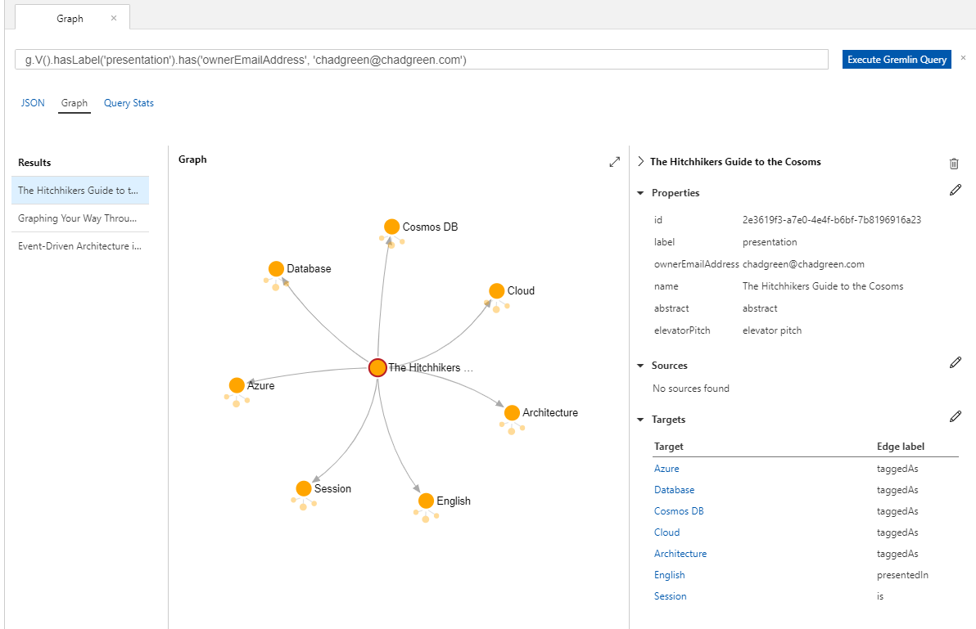
Graph API – How: Data Model
Wide-Range of Data APIs
Notes:
Highly hierarchical data

Slide 88
Graph API – How: Data Model
Wide-Range of Data APIs
g.V().hasLabel
(‘presentation’)
.has(‘ownerEmailAddress’, ‘chadgreen@chadgreen.com’)
Notes:
Highly hierarchical data

Slide 89
Graph API – How: Insert
Wide-Range of Data APIs
g.addV('presentation')
.property('ownerEmailAddress', 'chadgreen@chadgreen.com')
.property('name', 'The Hitchhikers Guide to the Cosmos')
.property('abstract', 'This is a really cool talk!')
.property('elevatorPitch', 'Cool talk!')
Notes:
Highly hierarchical data

Slide 90
Graph API – How: Insert
Wide-Range of Data APIs
private static Task<ResultSet<dynamic>> SubmitRequest(GremlinClient gremlinClient,
KeyValuePair<string, string> query)
{
try
{
return gremlinClient.SubmitAsync<dynamic>(query.Value);
}
catch (ResponseException e)
{
Console.WriteLine("\tRequest Error!");
Console.WriteLine($"\tStatusCode: {e.StatusCode}");
PrintStatusAttributes(e.StatusAttributes);
Console.WriteLine($"\t[\"x-ms-retry-after-ms\"] :
{ GetValueAsString(e.StatusAttributes, "x-ms-retry-after-ms")}");
Console.WriteLine($"\t[\"x-ms-activity-id\"] :
{ GetValueAsString(e.StatusAttributes, "x-ms-activity-id")}");
throw;
}
}
Notes:
Highly hierarchical data

Slide 91
Graph API – How: Insert
Wide-Range of Data APIs
private static Task<ResultSet<dynamic>> SubmitRequest(GremlinClient gremlinClient,
KeyValuePair<string, string> query)
{
try
{
return gremlinClient.SubmitAsync<dynamic>(query.Value);
}
catch (ResponseException e)
{
Console.WriteLine("\tRequest Error!");
Console.WriteLine($"\tStatusCode: {e.StatusCode}");
PrintStatusAttributes(e.StatusAttributes);
Console.WriteLine($"\t[\"x-ms-retry-after-ms\"] :
{ GetValueAsString(e.StatusAttributes, "x-ms-retry-after-ms")}");
Console.WriteLine($"\t[\"x-ms-activity-id\"] :
{ GetValueAsString(e.StatusAttributes, "x-ms-activity-id")}");
throw;
}
}
Notes:
Highly hierarchical data

Slide 92
Graph API – How: Insert
Wide-Range of Data APIs
private static Task<ResultSet<dynamic>> SubmitRequest(GremlinClient gremlinClient,
KeyValuePair<string, string> query)
{
try
{
return gremlinClient.SubmitAsync<dynamic>(query.Value);
}
catch (ResponseException e)
{
Console.WriteLine("\tRequest Error!");
Console.WriteLine($"\tStatusCode: {e.StatusCode}");
PrintStatusAttributes(e.StatusAttributes);
Console.WriteLine($"\t[\"x-ms-retry-after-ms\"] :
{ GetValueAsString(e.StatusAttributes, "x-ms-retry-after-ms")}");
Console.WriteLine($"\t[\"x-ms-activity-id\"] :
{ GetValueAsString(e.StatusAttributes, "x-ms-activity-id")}");
throw;
}
}
Notes:
Highly hierarchical data

Slide 93
Graph API – How: Query
Wide-Range of Data APIs
g.V()
.hasLabel('tag’)
.has('name’, 'Azure’)
.in('taggedAs’)
.hasLabel('presentation')
Notes:
Highly hierarchical data

Slide 94
Gremlin API – Querying Options
Wide-Range of Data APIs
API
JavaScript
SQL API
Notes:
API (using Gremlin.Net)
Community API (Gremlin.Net.CosmosDb)
JavaScript
Stored Procedures
Triggers
User Defined Functions
SQL API

Slide 95

Cassandra API
Wide Column Store

Slide 96
Cassandra API – What
Wide-Range of Data APIs
Handle Large Amounts of Data
Uses Commodity Servers
Developed by Facebook
Notes:
Open-source, distributed, wide column store, NoSQL database
Designed to handle large amounts of data
Uses many commodity servers, providing high availability
Developed to power the Facebook inbox search feature
Apache Cassandra is a free and open-sourced, distributed, wide column store, NoSQL database management system designed to handle large amounts of data across many commodity servers, providing high availability with no single point of failure.
Wide column store – uses tables, rows, and columns, but unlike a relational database, the names and formats of the columns can very from row to row in the same table. – can be interpreted as a two-dimensioned key-value store

Slide 97
Graph API – When
Wide-Range of Data APIs
Migrating data from Cassandra to Azure Cosmos DB
Notes:
Highly hierarchical data

Slide 98
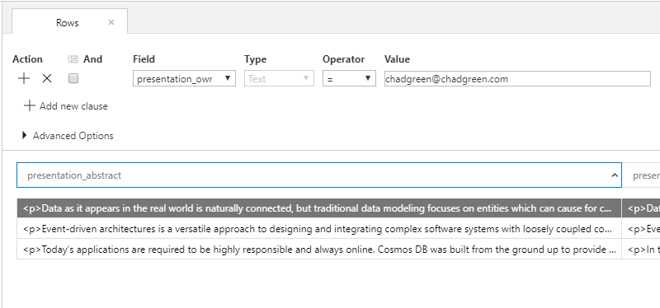
Cassandra API – How: Data Model
Wide-Range of Data APIs
Notes:
Highly hierarchical data

Slide 99
Cassandra API – How: Insert
Wide-Range of Data APIs
public class Presentation
{
public string presentation_id { get; set; }
public string presentation_owneremailaddress { get; set; }
public string presentation_title { get; set; }
public string presentation_abstract { get; set; }
public string presentation_elevatorpitch { get; set; }
public string presentation_importantinformation { get; set; }
public string presentation_languagecode { get; set; }
public string presentation_language { get; set; }
}
Notes:
Highly hierarchical data

Slide 100
Cassandra API – How: Insert
Wide-Range of Data APIs
var options = new Cassandra.SSLOptions(SslProtocols.Tls12,
true, ValidateServerCertificate);
options.SetHostNameResolver((ipAddress) => CassandraContactPoint);
Cluster cluster = Cluster.Builder()
.WithCredentials(UserName, Password)
.WithPort(CassandraPort)
.AddContactPoint(CassandraContactPoint).WithSSL(options).Build();
ISession session = cluster.Connect();
session = cluster.Connect("speakingengagements");
IMapper mapper = new Mapper(session);
// Inserting Data into presentation table
mapper.Insert<Presentation>(Generate.Presentation(
ExistingPresentation.EventDrivenArchitectureInTheCloud));
Notes:
Highly hierarchical data

Slide 101
Cassandra API – How: Query
Wide-Range of Data APIs
Presentation presentationId3 = mapper.FirstOrDefault<Presentation>
("Select * from presentation where presentation_owneremailaddress = ?",
"chadgreen@chadgreen.com");
Console.WriteLine(presentationId3.presentation_title);
Notes:
Highly hierarchical data

Slide 102
Cassandra API – Query Options
Wide-Range of Data APIs
API
CQL
Cassandra-Based Tools
Notes:
API (using CassandraCSharpDriver)
Cassandra Query Language (CQL)
Cassandra-based tools (like cqlsh)

Slide 103

Table API
Table Storage

Slide 104
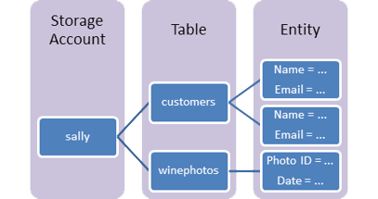
Table API – What
Wide-Range of Data APIs
Store Large Amounts of Data
Storing Structured Non-Related Data
Notes:
Common uses:
Storing TBs of structured data capable of serving web scale applications
Storing datasets that do not require complex joins, foreign keys, or stored procedures and be denormalized for fast access
Quickly querying data using a clustered index
Accessing data using the OData protocol and LINQ queries

Slide 105
Table API – When
Wide-Range of Data APIs
Migrating data from Azure Table storage to Cosmos DB

Slide 106
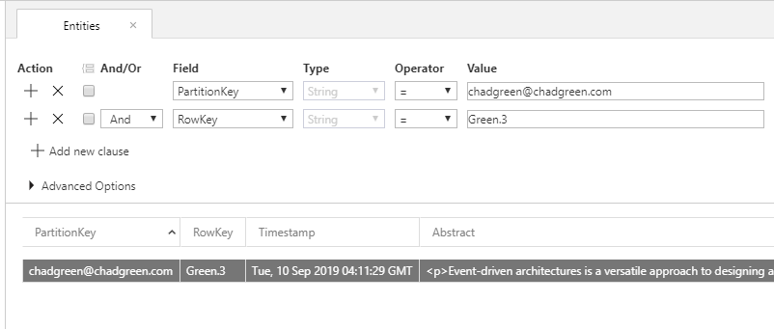
Table API – How: Data Model
Wide-Range of Data APIs

Slide 107
Table API – How: Insert
Wide-Range of Data APIs
public class Presentation : TableEntity
{
public Presentation() { }
public Presentation(string id, string ownerEmailAddress)
{
PartitionKey = ownerEmailAddress;
RowKey = id;
}
public string Title { get; set; }
public string Abstract { get; set; }
public string ElevatorPitcch { get; set; }
public string ImportantDetails { get; set; }
public string LanguageCode { get; set; }
public string Langauge { get; set; }
}

Slide 108
Table API – How: Insert
Wide-Range of Data APIs
public class Presentation : TableEntity
{
public Presentation() { }
public Presentation(string id, string ownerEmailAddress)
{
PartitionKey = ownerEmailAddress;
RowKey = id;
}
public string Title { get; set; }
public string Abstract { get; set; }
public string ElevatorPitcch { get; set; }
public string ImportantDetails { get; set; }
public string LanguageCode { get; set; }
public string Langauge { get; set; }
}

Slide 109
Table API – How: Insert
public static async Task<Presentation> InsertOrMergeEntityAsync(CloudTable table, Presentation entity)
{
if (entity == null)
{
throw new ArgumentNullException("entity");
}
try
{
// Create the InsertOrReplace table operation
TableOperation insertOrMergeOperation = TableOperation.InsertOrMerge(entity);
// Execute the operation.
TableResult result = await table.ExecuteAsync(insertOrMergeOperation);
Presentation insertedCustomer = result.Result as Presentation;
if (result.RequestCharge.HasValue)
{
Console.WriteLine("Request Charge of InsertOrMerge Operation: " + result.RequestCharge);
}
return insertedCustomer;
}
catch (StorageException e)
{
Console.WriteLine(e.Message);
Console.ReadLine();
throw;
}
}
Wide-Range of Data APIs

Slide 110
Table API – How: Insert
Wide-Range of Data APIs
public static async Task<Presentation> InsertOrMergeEntityAsync(CloudTable table, Presentation entity)
{
if (entity == null)
{
throw new ArgumentNullException("entity");
}
try
{
// Create the InsertOrReplace table operation
TableOperation insertOrMergeOperation = TableOperation.InsertOrMerge(entity);
// Execute the operation.
TableResult result = await table.ExecuteAsync(insertOrMergeOperation);
Presentation insertedCustomer = result.Result as Presentation;
if (result.RequestCharge.HasValue)
{
Console.WriteLine("Request Charge of InsertOrMerge Operation: " + result.RequestCharge);
}
return insertedCustomer;
}
catch (StorageException e)
{
Console.WriteLine(e.Message);
Console.ReadLine();
throw;
}
}

Slide 111
Table API – How: Query
public static async Task<Presentation> RetrieveEntityUsingPointQueryAsync(CloudTable table,
string partitionKey, string rowKey)
{
try
{
TableOperation retrieveOperation
= TableOperation.Retrieve<Presentation>(partitionKey, rowKey);
TableResult result = await table.ExecuteAsync(retrieveOperation);
Presentation presentation = result.Result as Presentation;
if (presentation != null)
{
Console.WriteLine("\t{0}\t{1}\t{2}", presentation.PartitionKey,
presentation.RowKey, presentation.Title);
}
if (result.RequestCharge.HasValue)
{
Console.WriteLine("Request Charge of Retrieve Operation: " + result.RequestCharge);
}
return presentation;
}
catch (StorageException e)
{
Console.WriteLine(e.Message);
Console.ReadLine();
throw;
}
}
Wide-Range of Data APIs

Slide 112
Table API – How: Query
Wide-Range of Data APIs
public static async Task<Presentation> RetrieveEntityUsingPointQueryAsync(CloudTable table,
string partitionKey, string rowKey)
{
try
{
TableOperation retrieveOperation
= TableOperation.Retrieve<Presentation>(partitionKey, rowKey);
TableResult result = await table.ExecuteAsync(retrieveOperation);
Presentation presentation = result.Result as Presentation;
if (presentation != null)
{
Console.WriteLine("\t{0}\t{1}\t{2}", presentation.PartitionKey,
presentation.RowKey, presentation.Title);
}
if (result.RequestCharge.HasValue)
{
Console.WriteLine("Request Charge of Retrieve Operation: " + result.RequestCharge);
}
return presentation;
}
catch (StorageException e)
{
Console.WriteLine(e.Message);
Console.ReadLine();
throw;
}
}

Slide 113
etcd API
Key-Value Storge

Slide 114

etcd API – What
Wide-Range of Data APIs
Simple
Secure
Fast
Reliable
Notes:
etcd is a distributed reliable key-value store for the most critical data of a distributed system, with a focus on being:
Simple: well-defined, user-facing API (gRPC)
Secure: automatic TLS with optional client cert authentication
Fast: benchmarked 10,000 writes/sec
Reliable: properly distributed using Raft

Slide 115
etcd API – Why
Wide-Range of Data APIs
No etcd Operations Management
Notes:
No etcd operations management
As a fully managed native cloud service, Azure Cosmos DB removes the need for Kubernetes developers to set up and manage etcd. The etcd API in Azure Cosmos DB is scalable, highly available, fault tolerant, and offers high performance. The overhead of setting up replication across multiple nodes, performing rolling updates, security patches, and monitoring the etcd health are handled by Azure Cosmos DB.

Slide 116
etcd API – Why
Wide-Range of Data APIs
No etcd Operations Management
Notes:
No etcd operations management
As a fully managed native cloud service, Azure Cosmos DB removes the need for Kubernetes developers to set up and manage etcd. The etcd API in Azure Cosmos DB is scalable, highly available, fault tolerant, and offers high performance. The overhead of setting up replication across multiple nodes, performing rolling updates, security patches, and monitoring the etcd health are handled by Azure Cosmos DB.

Slide 117
etcd API – Why
Wide-Range of Data APIs
No etcd Operations Management
Global distribution & high availability
Notes:
Global distribution & high availability
By using etcd API, Azure Cosmos DB guarantees 99.99% availability for data reads and writes in a single region, and 99.999% availability across multiple regions.

Slide 118
etcd API – Why
Wide-Range of Data APIs
No etcd Operations Management
Global distribution & high availability
Notes:
Global distribution & high availability
By using etcd API, Azure Cosmos DB guarantees 99.99% availability for data reads and writes in a single region, and 99.999% availability across multiple regions.

Slide 119
etcd API – Why
Wide-Range of Data APIs
No etcd Operations Management
Elastic scalability
Global distribution & high availability
Notes:
Elastic scalability
Azure Cosmos DB offers elastic scalability for read and write requests across different regions. As the Kubernetes cluster grows, the etcd API account in Azure Cosmos DB elastically scales without any downtime. Storing etcd data in Azure Cosmos DB, instead of the Kubernetes master nodes also enables more flexible master node scaling.

Slide 120
etcd API – Why
Wide-Range of Data APIs
No etcd Operations Management
Elastic scalability
Global distribution & high availability
Notes:
Elastic scalability
Azure Cosmos DB offers elastic scalability for read and write requests across different regions. As the Kubernetes cluster grows, the etcd API account in Azure Cosmos DB elastically scales without any downtime. Storing etcd data in Azure Cosmos DB, instead of the Kubernetes master nodes also enables more flexible master node scaling.

Slide 121
etcd API – Why
Wide-Range of Data APIs
No etcd Operations Management
Elastic scalability
Security & enterprise readiness
Global distribution & high availability
Notes:
Security & enterprise readiness
When etcd data is stored in Azure Cosmos DB, Kubernetes developers automatically get the built-in encryption at rest, certifications and compliance, and backup and restore capabilities supported by Azure Cosmos DB.

Slide 122
etcd API – When
Wide-Range of Data APIs
Allows developers to scale Kubernetes state management on a fully managed cloud native PaaS service

Slide 123

Call to Action
The Hitchhiker’s Guide to the Cosmos

Slide 124
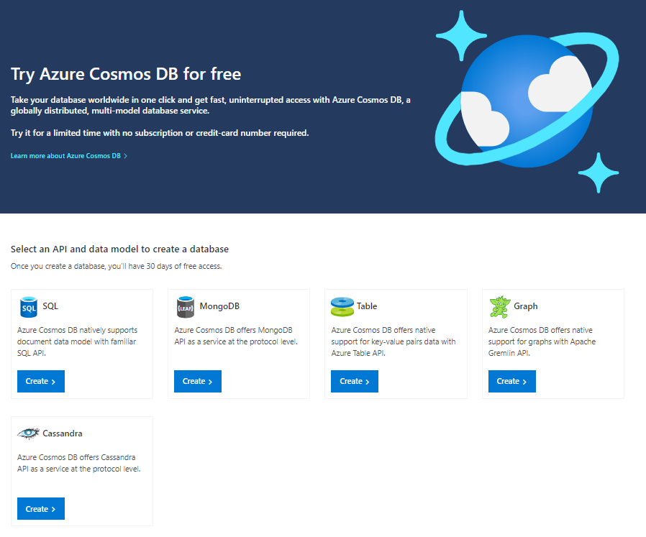
azure.Microsoft.com/en-us/try/cosmosdb
Notes:
Shared throughput database with a maximum of 25 containers and 20,000 RU/s of throughput, or one container with up to 5000 RU/s.

Slide 125
Free Database

Slide 126
Free Database

Slide 127
Free Database
1000 RU/s
25-Gb
Notes:
But wait, there’s more

Slide 128
Serverless

Slide 129
Thank You!
chadgreen@chadgreen.com
TaleLearnCode
TaleLearnCode.com
ChadGreen & TaleLearnCode
ChadwickEGreen

